Slide 1

Healthcare Data Management System

Slide 2

Objective
To create a robust, relational database that captures the essential components of healthcare operations.
This includes:
Efficient patient management
Detailed treatment records
Comprehensive billing information

Slide 3



Technology Stack
ORACLE SQL DEVELOPER
PLSQL
NODE JS & REACT

Slide 4
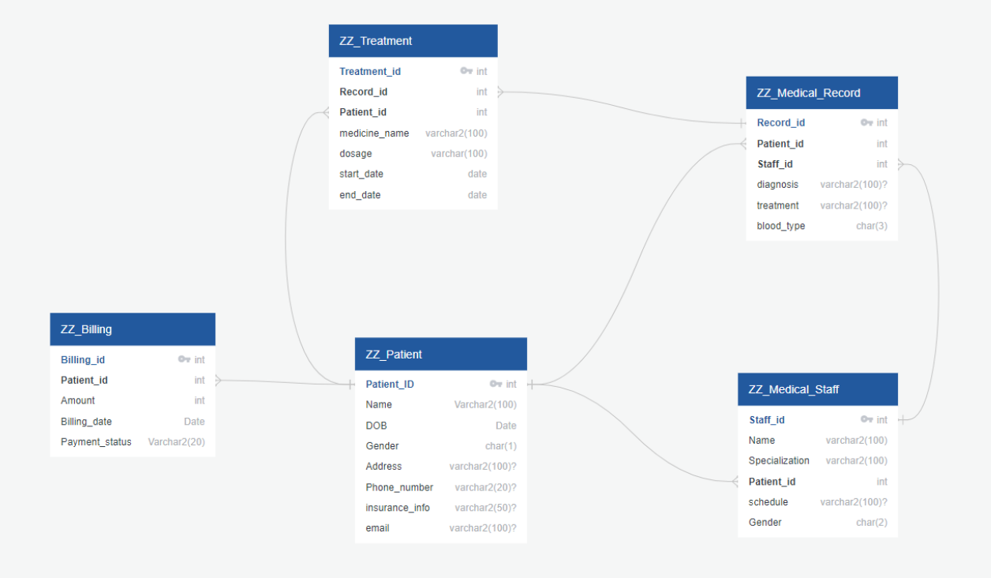
Database Structure

Slide 5
PLSQL Objects
Procedures
1. Update_patient_email
2. retrieve_patient_information
Triggers
1. ZZ_billing_trg
2. ZZ_staffidchg_trg
Functions
1. get_medical_record_count
2.get_total_billing_amount
Packages
1. health_pkg
Notes:
Procedures and Functions
update_patient_email Procedure: Updates the email address for a specific patient in the ZZ_Patients table, identified by patient_id, and outputs a success message.
retrieve_patient_information Procedure: Retrieves and displays detailed information for a specific patient from the ZZ_Patients table.
get_medical_record_count Function: Returns the count of medical records for a given patient, identified by patient_id.
get_total_billing_amount Function: Calculates and returns the total billing amount for a given patient, consolidating entries from the ZZ_Billing table.
Package health_pkg
Contains the aforementioned procedures and functions.
Includes a constant clinicID representing the clinic's identification number.
The package body provides the implementation details for the declared procedures and functions.
Test Script for Package
Executes the procedures and functions within the health_pkg to demonstrate their functionality, specifically:
Retrieving the medical record count for a patient.
Updating a patient's email.
Getting the total billing amount for a patient.
Retrieving patient information.
Displaying the clinic's ID using the package's global variable.
Triggers
ZZ_BILLING_TRG Trigger: Automatically inserts a billing record for new patients added to the ZZ_Patients table. It sets a default billing amount and marks the payment status as 'Unpaid'.
ZZ_staffidchg_trg Trigger: Ensures referential integrity by updating the staff_id in the ZZ_Medical_Record table when it is changed in the ZZ_Medical_Staff table, thereby maintaining consistency across related records.

Slide 6
LIVE SCRIPT EXECUTION

Slide 7
WEB APP DEMONSTRATION

